Slide 1
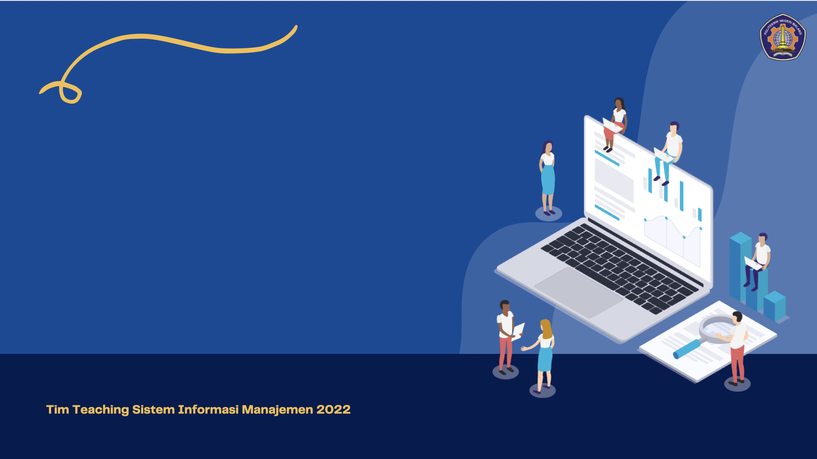
BASIC CONCEPTS OF INFORMATION TECHNOLOGY
SISTEM INFORMASI MANAJEMEN
JURUSAN TEKNOLOGI INFORMASI

Slide 2

Introduction
All leaders or managers who are responsible for an organization need to use a holistic approach in the decision-making process, especially in setting goals, allocating resources, and making plans.
Data and information is a basic material in the preparation of information systems so that an understanding of data and information and information systems is very important.

Slide 3
Information Technology
Information technology is the study or electronic equipment, especially computers, for storing, analyzing, and distributing information including words, numbers, and images (Oxford Dictionary, 1995).
Information technology is not only limited to computer technology (software & hardware) used to process or store information, but also includes communication technology to transmit information (Martin, 1999).
Implicitly and explicitly, information technology is not only in the form of computer technology, but also includes communication technology. In other words, what is called information technology is a combination of computer technology and telecommunications technology.

Slide 4
Information Technology Concept
The term information technology began to be widely used to replace management information systems. The term information technology (IT) is more technology-oriented. Information technology (IT) is a sub-system or system part of an information system.
The term information systems technology (TSI) or information systems technology (IST) also denotes the technology used by information systems. The term information systems technology has a similar meaning to information technology (IT) or information technology (IT).
A computer system is also an information technology used in information systems. Information technology can be any technology that can produce information, including computer technology and telecommunications technology. Thus, the computer system is a subsystem or system part of information technology.

Slide 5
Information Technology Grouping
Input technology
Processing machine
Storage technology (internal and external)
Output technology
Software
Notes:
Teknologi penyimpanan dibedakan menjadi dua kelompok, yaitu memori internal dan penyimpanan eksternal. Memori internal (main memory atau memori utama) berfungsi sebagai pengikat sementara, baik bagi data, program, maupun informasi ketika proses pengolahannya dilaksanakan oleh CPU. Contoh memori internal, yaitu ROM dan RAM. Read Only Memory (ROM) adalah memori yang hanya dapat dibaca, sedangkan Read Access Memory (RAM) adalah memori yang isinya dapat diperbaharui. Penyimpanan eksternal (external storage) dikenal juga dengan sebutan penyimpanan sekunder. Teknologi keluaran (output technology) adalah teknologi yang berhubungan dengan semua piranti yang berfungsi untuk menyajikan informasi hasil pengolahan sistem. Layar, monitor, dan printer merupakan piranti keluaran

Slide 6
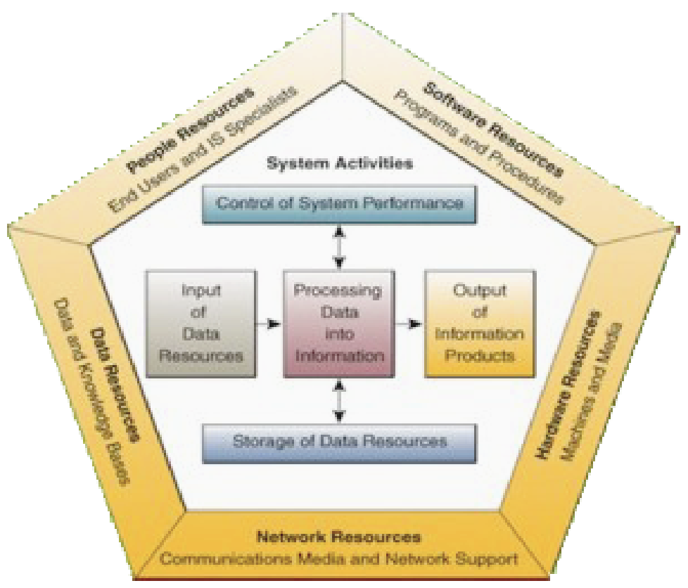
Information Technology System Components

Slide 7
Information Technology System Classification
According to system function: Embedded IT system, dedicated IT system, and general-purpose IT system.
By department: Accounting information system and marketing information system.
According to support for management level within the company: Transaction processing systems and decision support systems.
By size and way of serving requests: Client-server.
Notes:
Fungsi: Embedded, dedicated, general purpose
Menurut departemen: SI Akutansi, SI pemasaran, SI Produksi
Menurut dukungan terhadap level manajemen: sistem pemrosesan transaksi, sistem pendukung keputusan dan sistem informasi eksekutif

Slide 8

The Role of Information Technology
Information technology has become the main facilitator for business activities, contributing greatly to fundamental changes in organizational structure, operations and management.
Examples of the results of the application of information technology: withdrawal of money through Automated Teller Machines (ATM), transactions via the internet known as e-commerce or electronic commerce, money transfers through e-banking facilities that can be done from home.
The role of information technology can be used as a means of cooperation between individuals or groups with other individuals or groups without recognizing the boundaries of distance and time, country, race, economic class, ideology, or other factors that can hinder the exchange of ideas.

Slide 9
Information Technology Trends
Increased speed and capacity of electronic components
The availability of information in digital form is increasing
The portability of electronic equipment is increasing
Improved connectivity
Ease of use increased

Slide 10
Information Technology Development (1)
Understanding the development of information technology
The development of information technology spurred a new way of life, from life begins to end. This life is known as e-life, meaning that life has been influenced by various needs electronically.
Technological discovery
Towards the turn of the current century, humans tend to occupy a central place in the production process because this economic stage is knowledge based and information focused. In this case, telecommunications and informatics play a role as a key technology (enabler technology).

Slide 11
Information Technology Development(2)
Information technology advancement
Advances in information technology and telecommunications are so rapid that new, more efficient ways of producing, distributing, and consuming goods and services are applied. It is this process that brings people into the information society or economy. Life in the future, the information technology and telecommunications sector is the most dominant sector. Information technology has many roles in education (e-education).
Use of information technology
Humans are social creatures. Besides clothing, food, and shelter as their main needs, as social beings, humans need communication between each other so that they can be interconnected. Therefore, humans seek and create systems and tools to interact with each other. The communication tools and systems created by humans are then called information technology or "IT", an abbreviation of Information Technology.

Slide 12
Let’s Discuss

